Slide 1
FRACCIÓN A DECIMAL
Matemática 6
Prof. Samuel Vélez

Slide 2
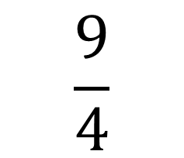
2
2
5
$$\frac{9}{4}$$
.
4
.0
0
0
9
0
4 x 2 = 8
8
1
8
2
20
0

Slide 3
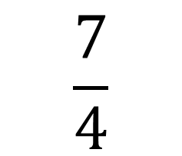
7
1
5
$$\frac{7}{4}$$
.
4
.0
0
0
7
0
4 x 1 = 4
4
3
28
2
20
0

Slide 4
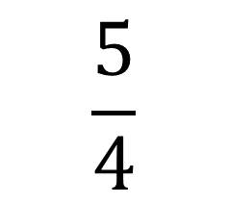
2
1
5
$$\frac{5}{4}$$
.
4
.0
0
0
5
0
4 x 1 = 4
4
1
8
2
20
0

Slide 5
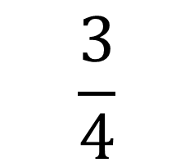
7
0
5
$$\frac{3}{4}$$
.
4
.0
0
0
3
0
4 x 0 = 0
0
3
28
2
20
0

Slide 6
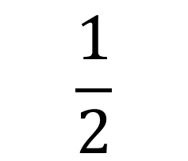
0
5
$$\frac{1}{2}$$
.
2
.0
1
0
0
1
10
0

Slide 7
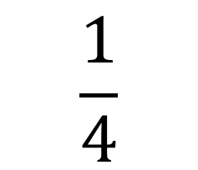
2
0
5
$$\frac{1}{4}$$
.
4
.0
0
0
1
0
0
1
8
2
20
0

Slide 8
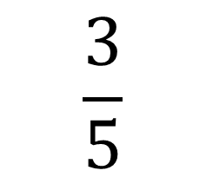
0
6
$$\frac{3}{5}$$
.
5
.0
3
0
0
3
30
0

Slide 9
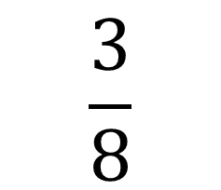
0
3
7
5
$$\frac{3}{8}$$
.
8
.0
0
0
0
3
0
0
0
3
24
6
56
4
40

